Slide 1
Web Monitoring of online vaccine conversations and sentiments as a public health surveillance tool
Vaccine Coverage Monitoring and Initiatives
Public Health Agency of Canada
Notes:
Social listening suggests more activite and comprehensive approach that seeks not only to monitor but to deeply understand the conversations
‹#›

Slide 2
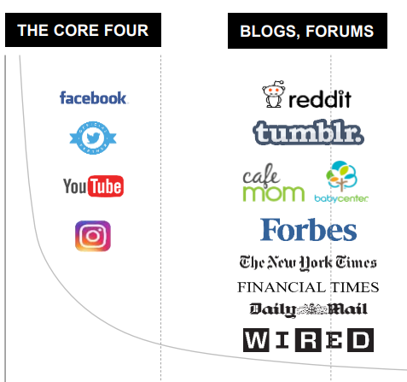
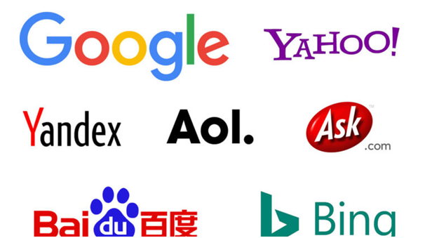
Navigating the complex and rapidly evolving landscape of diverse perceptions and experiences that shape vaccination behaviors can be challenging. In response, there's a growing need to have a timelier pulse on these dynamics
What is web monitoring ?
Web monitoring also referred to as infoveillance which focuses on monitoring and analysis of conversations, discussions, and sentiments from various online sources including social media, websites, forums, and other online spaces.
How can web monitoring help?
In the context of vaccines, this practice offers valuable insights into how people are talking about, thinking about, and perceiving vaccines. It helps uncover experiences, concerns, questions, and perceptions.
Online text data provides in real-time, qualitative, abundant, and relatively easy to access information. By incorporating web monitoring, we equip ourselves with real-time insights that play a pivotal role in shaping effective communication strategies, policies, and targeted interventions for early intervention.
Query from search engines
VCMI aims to leverage web monitoring to enhance immunization surveillance. Our goal is to assess the potential and possibilities of this approach.
‹#›
Notes:
‹#›

Slide 3
Summary of projects operated by VCMI
To address existing data gaps for immunization coverage among at-risk populations, VCMI is conducting several surveys to assess COVID-19 and mpox vaccine status, intent to vaccinate, knowledge of, attitudes towards, beliefs, and barriers.
Vulnerable and Hard-to-Reach Populations COVID-19 Immunization Coverage Survey (VHCICS)
Mpox immunization Coverage Survey in 2SLGBTQI+ and MSM​
Childhood Immunization Coverage Survey in Key Populations (KPCICS)
KPCICS includes four surveys aimed at investigating recommended childhood and COVID-19 immunization uptake among children from different target parent population groups in Canada.
2SLGBTQI+ and MSM Parents
Recent Immigrant Parents​​
Indigenous Parents​
Health Care Worker Parents​
COVID-19 and Vaccination Coverage in Black Communities Survey
This project is a partnership with Interdisciplinary Centre for Black Health (University of Ottawa). The objectives are:
Bridge data gaps on COVID-19 vaccination coverage in Black communities throughout Canada.
Organizing a health promotion campaign aiming to boost COVID-19 uptake in these communities
Developing a pan-Canadian network of Black Peer Research Associates (PRA) that can support future vaccination campaigns.
‹#›
Notes:
‹#›

Slide 4
As we navigate the feasibility and potential impact of our approach, our initiative is guided by the following questions.
How are individuals discussing the perceived risk of the illness and the perceived efficacy of the vaccine?
What are the emerging trends and themes in vaccine conversations that might impact public health strategies?
What are some concerns and questions that people express about vaccines?
What vaccine side effects and safety concerns are being expressed?
What misinformation or misconceptions are circulating online regarding vaccines?
How are people discussing vaccine accessibility and distribution?
How have sentiments about vaccines changed over time? What are the key factors driving these shifts in public attitudes?
How are people reacting to and interpreting vaccine-related information from public health authorities?
Are there demographic or regional variations in vaccine-related discussions?
‹#›
Notes:
‹#›

Slide 5
Web monitoring can help answer these questions using the following metrics and analysis
Volume and Reach
Track # mentions, impressions, and engagement levels to gauge the extent of discussions
Sentiment Analysis
Evaluate positive, negative, and neutral sentiments to comprehend public attitudes
Topic and Theme Analysis
Identify keywords, hashtags, and trending topics to capture prevailing themes
Contextual Narrative Analysis
Dive deeper into the specific content to understand the context, emotions, and underlying reasons why
Time-based and Trend Analysis
Analyze sentiment and topics over time, and correlate spikes/shifts with event
Demographic Insights
Segmenting posts by age and location to gain demographic insights
We value both quantitative and qualitative analytic approaches for a comprehensive view. Quantitative reveals trends, while qualitative uncovers why, shedding light on experiences, sentiments, and reasons. We'll explore the application of both methodologies.
‹#›
Notes:
Qualitative analysis, which delves into the specific content of conversations, is essential to gain a deeper understanding of why people feel the way they do. This context helps you uncover the specific concerns, misconceptions, and experiences that shape sentiments. This approach allows you to not only identify the sentiment polarity but also understand the "why" behind those sentiments, enabling more informed decision-making and effective communication strategies.
‹#›

Slide 6
We are working towards a comprehensive taxonomy to search relevant web content
As we continue to expand our ability to algorithmically extract valuable information from online posts, we can develop different data-subsets and analyses based on a taxonomy of topics of interest relevant to understanding the factors, experiences, perceptions that shape vaccine behaviour.
Disease severity
Risk of disease
Vulnerability
Questions, concerns, confusion, narratives, sentiments, mis-information
Effectiveness
Side effects
Conversation on X vaccine
Symptoms/safety
Safety concerns
Distribution
Access
Availability
Information
Policies, regulations, mandates
Vaccine Guidance
Trust in advice
Misinformation
Questions
**Our initial pilot focus areas using Twitter, Reddit, and Google
Notes:
Taxonomy: a systematic classification of terms. In infodemic management context, this describes the terms used to organize coding of narratives, questions, concerns, information voids and circulating mis- and disinformation about a public health issue (allows you to align your search strategy with topics that are most relevant to your question
Help organize data and map what areas of public health topic information, perception, discussion, and behaviour are most concentrated, where conversations seem to be missing or silent, and where new topics or concerns may emerge.
‹#›

Slide 7
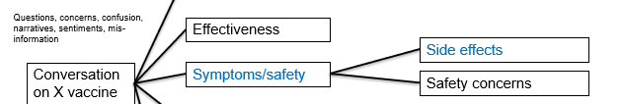
Initial Pilot Focus 1: What Symptoms and Safety Concerns are Being Expressed?
‹#›
Notes:
‹#›

Slide 8
Planned Approach
Analytic framework
Volume and Reach Metrics: Track the total number of related mentions and engagement related to symptoms and safety concerns.
Status: In development
Sentiment Analysis: Categorize sentiments as positive, negative, or neutral in relation to symptoms and safety concerns.
Status: In development
Topic and Theme Analysis: Identify frequently mentioned keywords, hashtags, and trending topics associated with symptoms and safety concerns.
Status: In development
Contextual Analysis: Analyze the content of posts
Status: under consideration
Time-based and Trend Analysis: Analyze the change, emerging trends/shifts in sentiments, topics, and engagement over time, correlate spikes in discussion with events, news, or vaccine-related developments
Status: in development
Demographic Analysis: Segment posts by age groups and geographic locations to understand variations in expressions of symptoms and safety concerns.
Status: under consideration
Target Key Insights and Benefits
Early Detection: Identify potential adverse reaction signals, supporting vaccine safety surveillance efforts.
Perceived Symptom Concern Detection: Identify and address specific symptoms of concern with tailored messages for reassurance.
Information voids detection: Identify gaps in information and fill these voids to prevent the rise of misinformation.
Safety concern themes: Identify safety concern areas and tailor communication to address prevalent worries.
Misinformation Detection: Identify and counteract misinformation by providing accurate information.
‹#›
Notes:
‹#›

Slide 9
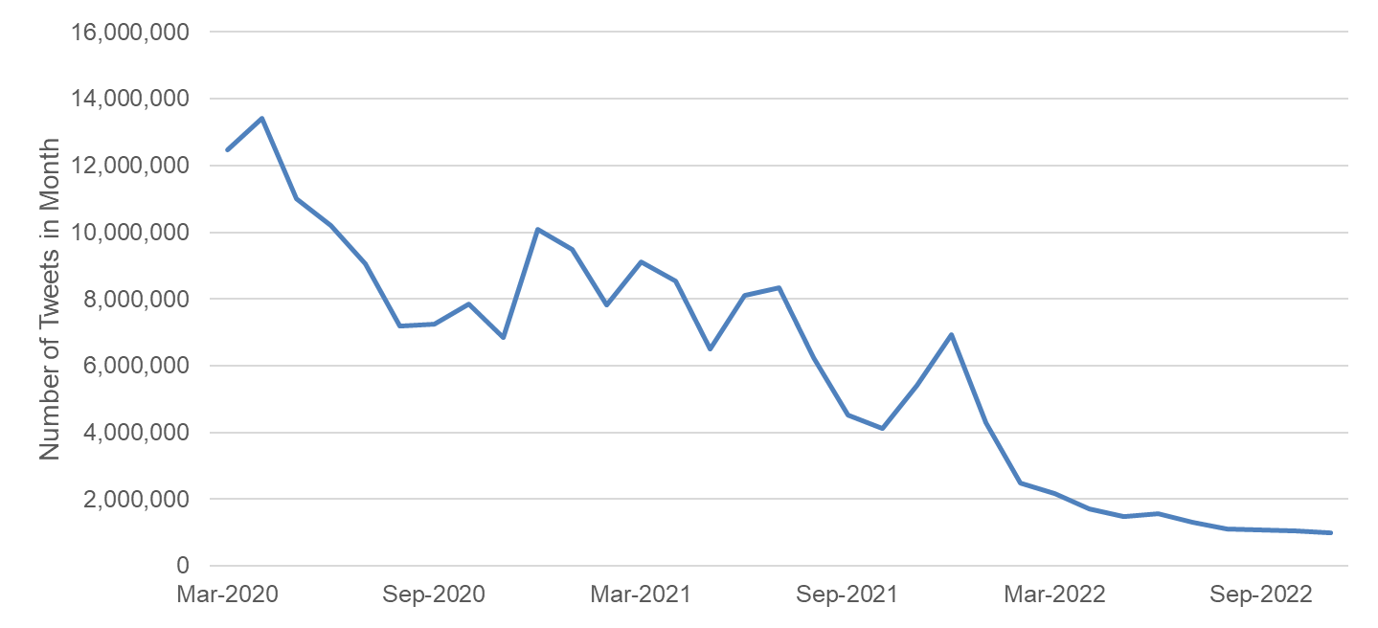
Distinguishing between concerns and questions vs personal experiences related to symptoms in vaccine-related conversations is challenging. To achieve this, we employ a multi-step process to filter out the noise.
Conventional keyword search
Fig: Number of tweets in a month (twitter's covid 19 data stream). Twitter Data includes: tweet text, date created, retweet count, and reply count.
2) Text-filtering
Filtering down to Tweets that matched terms from both dictionaries of medical symptoms and covid vaccines, 186,857 unique Tweets were found within the Covid Tweet dataset.
‹#›

Slide 10
3) Further classification and removal of noise using large language models.
There were a large number of Tweets where a symptom word was used in a non-medical context.
There were also Tweets that shared news about vaccines.
A binary variable was created to identify Tweets that were made as a genuine Personal Report of medical symptoms associated with vaccination. The model was trained on a large amount of manually labeled training data.
The model predicts the probability that a given Tweet is a Personal Report on a scale of 0 to 1.
Predicted Probability
This vaccine making my throat itch btw 🥴
BERT Transformer
(pretrained LLM)
Fully connected neural network (classifier)
1.0
Coronavirus: Can you get a vaccine shot if you have a cold or fever? - Times of India
0.0
Of 186k Tweets, about 30k were predicted to be a Personal Report with a probability of >0.5.
‹#›

Slide 11
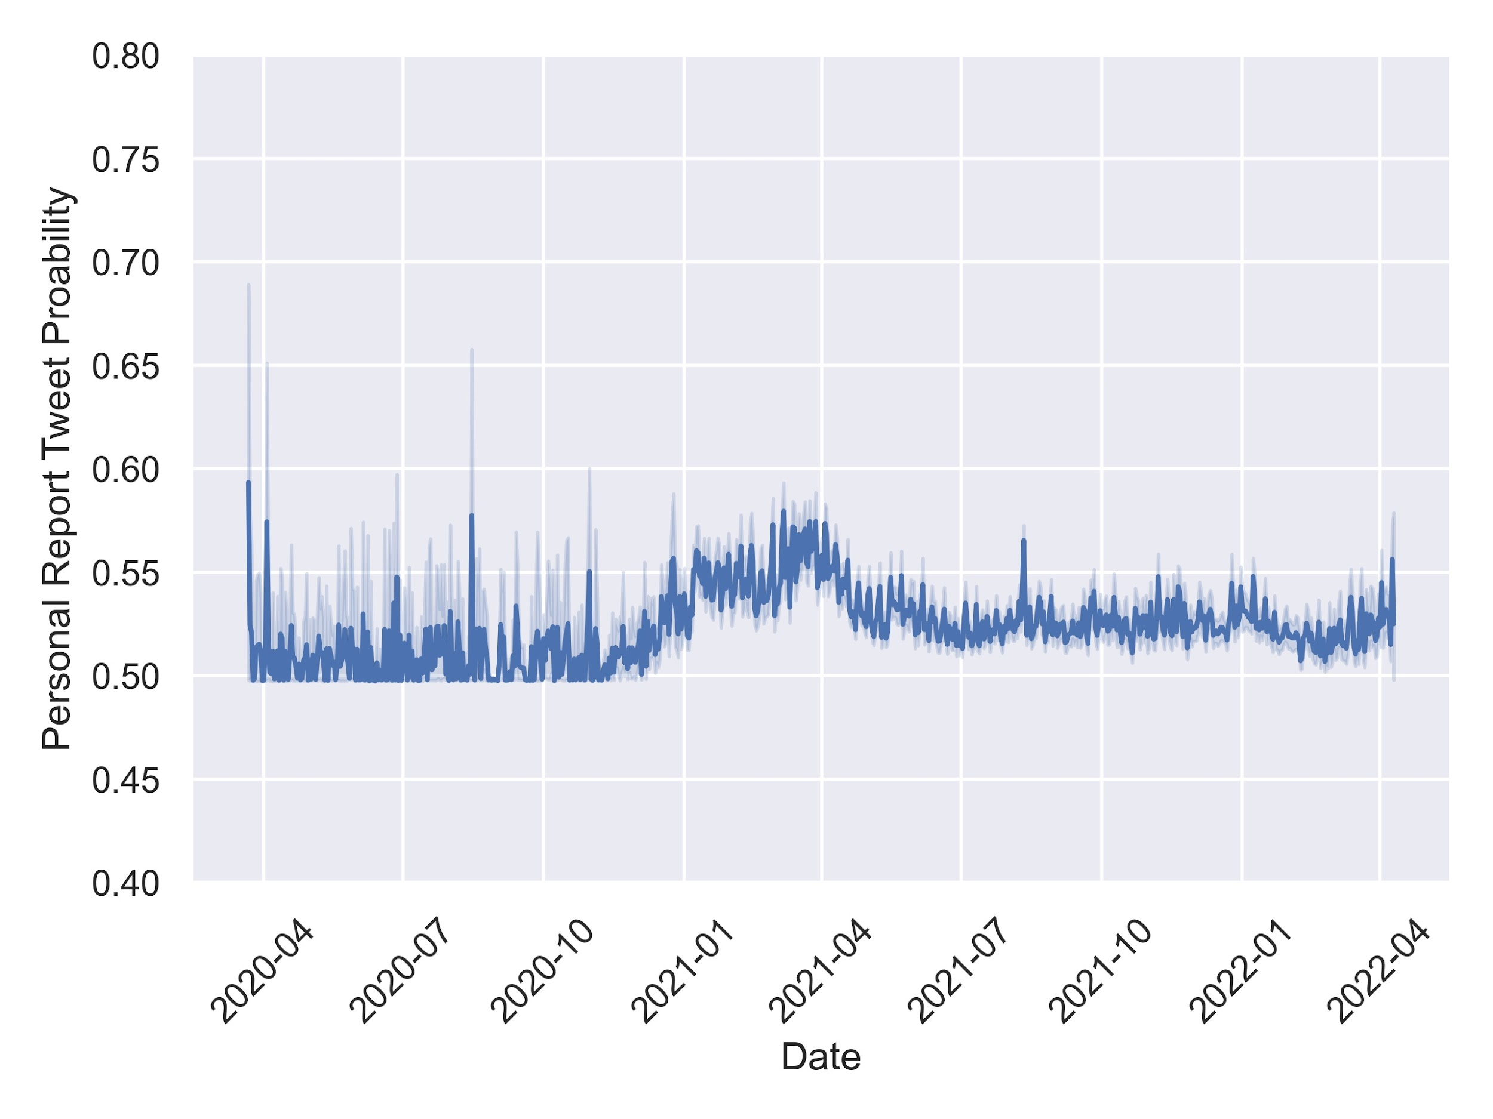
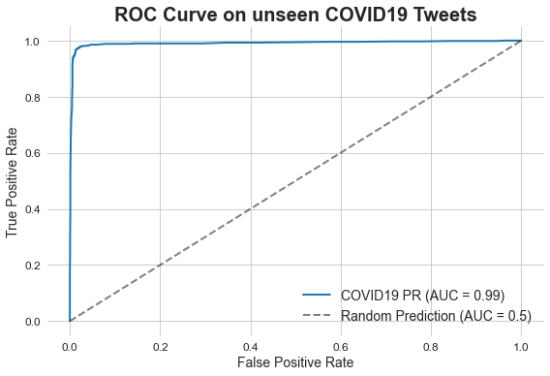
The algorithmic detection using COVID-19 tweets demonstrated strong performance
Text | Probability
2nd COVID-19 vaccine is currently kicking my ass. Body aches all over. | 0.7409
Left arm hurts a lot more now #FullyVaccinated #COVID19 #Moderna | 0.7409
See your doctor FIRST, before you get the vaccine, especially if you have autoimmune disorders. | 0.4956
Coronavirus: Can you get a vaccine shot if you have a cold or fever? - Times of India | 0.4957
Using our model, we investigated COVID tweets since the beginning of the pandemic
Pfizer vaccine approved for emergency use
Moderna vaccine approved for emergency use
There is a sudden jump in the daily average probability of symptoms reported as a personal report on Twitter.
We assessed the performance of the model in predicting Vaccine Symptom Tweets on a dataset that was not used for training. The area under the receiver operating characteristic curve indicated that the model accurately predicted the correct labels for nearly all the tweets.
‹#›
Notes:
‹#›

Slide 12
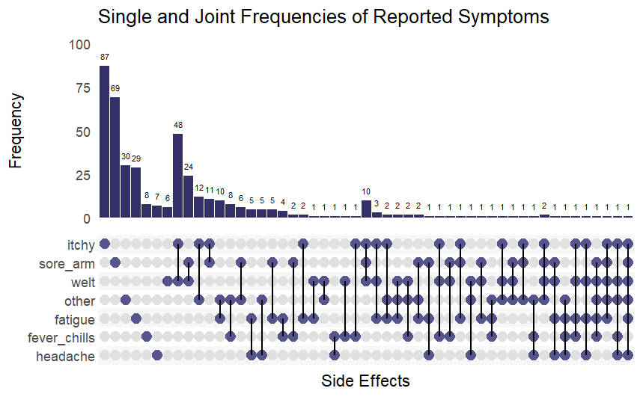
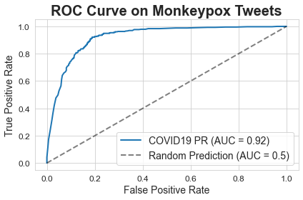
The algorithmic detection works for other diseases (i.e. mpox)
Monkeypox Tweet | Probability
The second vaccination for monkeypox was painful! | 0.7408
HOLY HECK the monkeypox (MPX) vaccine is so painful wtffffffff | 0.7408
At this time tests are only available for monkeypox if you have symptoms (e.g., sores, skin rashes, fever, swollen glands) and are at risk for monkeypox./nFor information about vaccine and who might qualify, call Health Link at 811./n/n#SexTalkYYC | 0.4962
Did those choosing not2wear a mask get priority for #Covid19 vaccination?Is #monkeypox more prevalent in Italy than Australia?Isnt it available in Italy?Are they free in Australia&amp;not in Italy?Everyone going to Africa could catch yellow fever but vax isn't free. #abcnews #auspol | 0.4961
Using our model, we investigated the kinds of vaccine symptoms are people reporting on twitter
The UpSet plot visually shows which symptoms are mentioned together in the same tweets. It helps identify the overlap or intersections between different symptoms mentioned in the tweets.
We found that many tweets mentioned more than one symptom.
Commonly mentioned symptoms include itchiness, sore arm, and welts
‹#›
We manually labeled an additional 1,145 tweets related to monkeypox that mentioned both vaccine and symptoms. Despite being trained on COVID-19 tweets, our classifier demonstrated the ability to generalize to a different disease like monkeypox.
‹#›

Slide 13
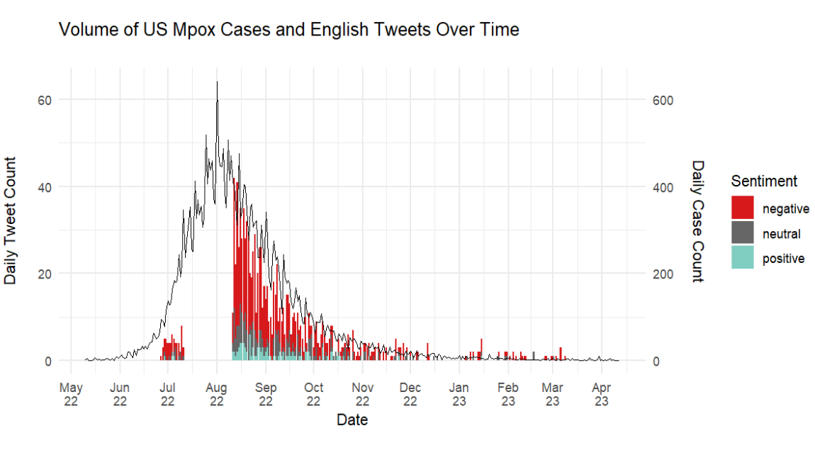
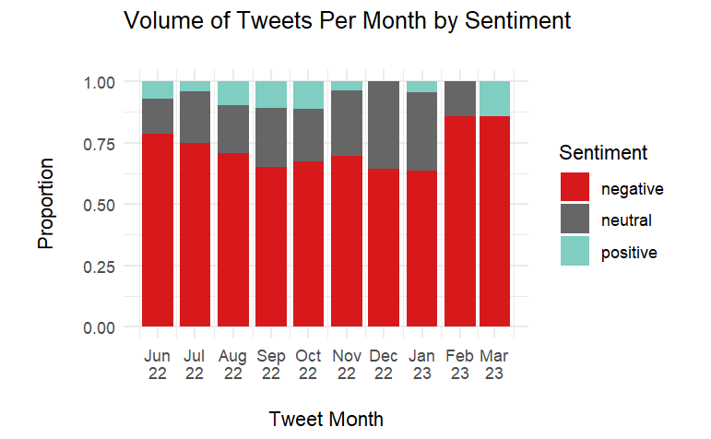
Furthermore, we examined methods for sentiment analysis to understand public attitudes towards mentioned vaccine symptoms, with a specific case example centered on Mpox
As expected, we see that most proportion of Vaccine Symptoms tweets is associated with a negative sentiment.
-By diving into sentiments linked to specific symptoms, we might be able to gain insights into how the public perceives different side effects.
-Conducting narrative analysis on negative sentiments might help reveal underlying concerns and misunderstandings. For instance, exploring the perceived severity of symptoms can provide valuable insights for addressing these concerns through targeted communication strategies.
We see that there is a lag between number of Vaccine Symptoms reported and reported number of cases (data was not acquired for August 2022)
‹#›

Slide 14
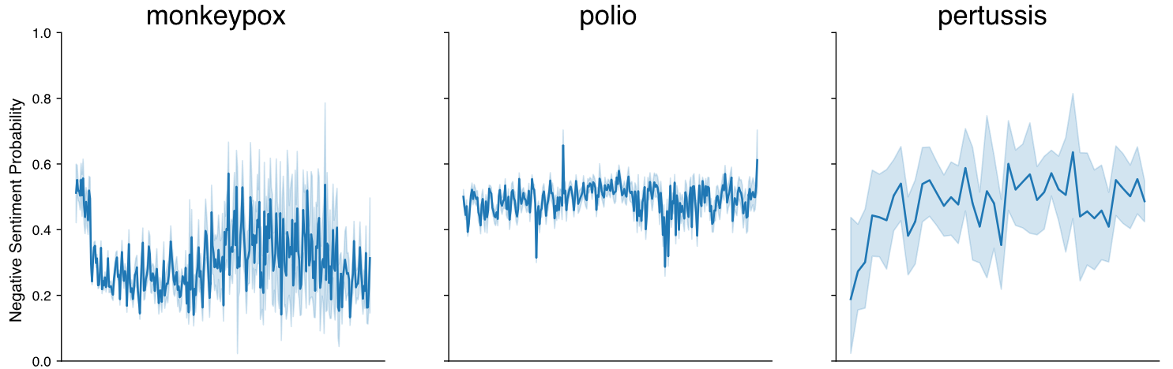
A further look into sentiment analysis
This shows sentiment on a broader set of data: all Tweets mentioning a vaccine, rather than Tweets mentioning both a vaccine and a symptom. This shows a clearer picture of how sentiment looks in online discussions towards vaccines themselves.
2022-06
2023-06
2022-08
2023-06
2023-04
2023-06
In mpox, even though peak vaccination in the US occurred in august 2022 (first dose), and september 2022 (second dose)1, there was a sudden and sustained spike of negative posts relating to mpox vaccines starting in january, 2023, well after peak vaccination had subsided.
https://www.cdc.gov/mmwr/volumes/72/wr/mm7213a4.htm#F1_down

Slide 15
Next Steps Pilot 1: As we move forward, we have identified key areas for enhancement and exploration:
Assess Alignment with CAEFISS Database: Collaborate with the Vaccine Safety team to ensure the alignment of first-report dates from Twitter Data with the CAEFISS database.
Define aberration detection approach: Develop strategy for detecting aberrations in the data related to specific symptom mentions.
Define Core Metrics and Visuals: Establish key metrics and visual representations for effective data dissemination.
Explore Methods for Expanding Scope: Investigate methods for broadening the scope of our analysis beyond symptom mentions to capture broader perceived safety concerns.
Explore Integration of Other Analytic Frameworks: Investigate the integration of additional analytic frameworks, such as topic and theme analysis, contextual narrative analysis, and potential demographic insights, into our evolving methodologies.
Explore Expansion Across Social Media Sources: Investigate the feasibility and methods for expanding our approach to analyze data from other social media sources beyond Twitter and Reddit.
‹#›

Slide 16
Initial Pilot Focus 2: High level overview of online activity
Disease severity
Risk of disease
Vulnerability
Questions, concerns, confusion, narratives, sentiments, mis-information
Effectiveness
Side effects
Conversation on X vaccine
Symptoms/safety
Safety concerns
Distribution
Access
Availability
Information
Policies, regulations, mandates
Vaccine Guidance
Trust in advice
Misinformation
Questions
‹#›
Notes:
Find time for available to connect on this. That sounds good……….
‹#›

Slide 17
Planned Approach
Analytic framework
Target Key Insights and Benefits
Signal Detection of Search Trends: Observe Google Trends top related terms to different diseases to detect the emergence of spikes in search activity.
Status: Completed and incorporated in dashboard
Geographic Analysis: Google Trends data can be filtered to geographic location, so data can be tracked by province, and comparisons between Canada and the US can be done.
Status: Completed and incorporated in dashboard
Emerging Issues Detection
Google Trends data captures volume of Google searches. Emerging concerns that people have relating to diseases can be identified using this source of data.
Compare relevance of issues in Canada and the US: This source of data can help determine whether or not Canada is well-aligned with the United States in terms of online traffic on a particular topic. This is particularly useful since most online sources of data do not include geography.
‹#›
Notes:
‹#›

Slide 18
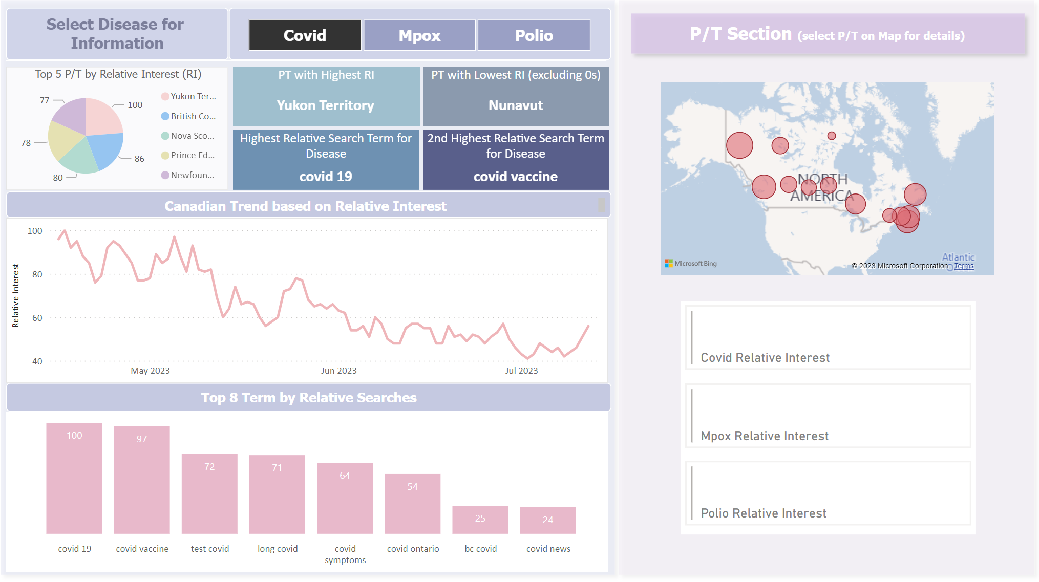
Public interest and concerns
This Google Trends dashboard highlights topics that the public are searching, by region, relating to a given disease (Covid-19, in this case).
‹#›

Slide 19
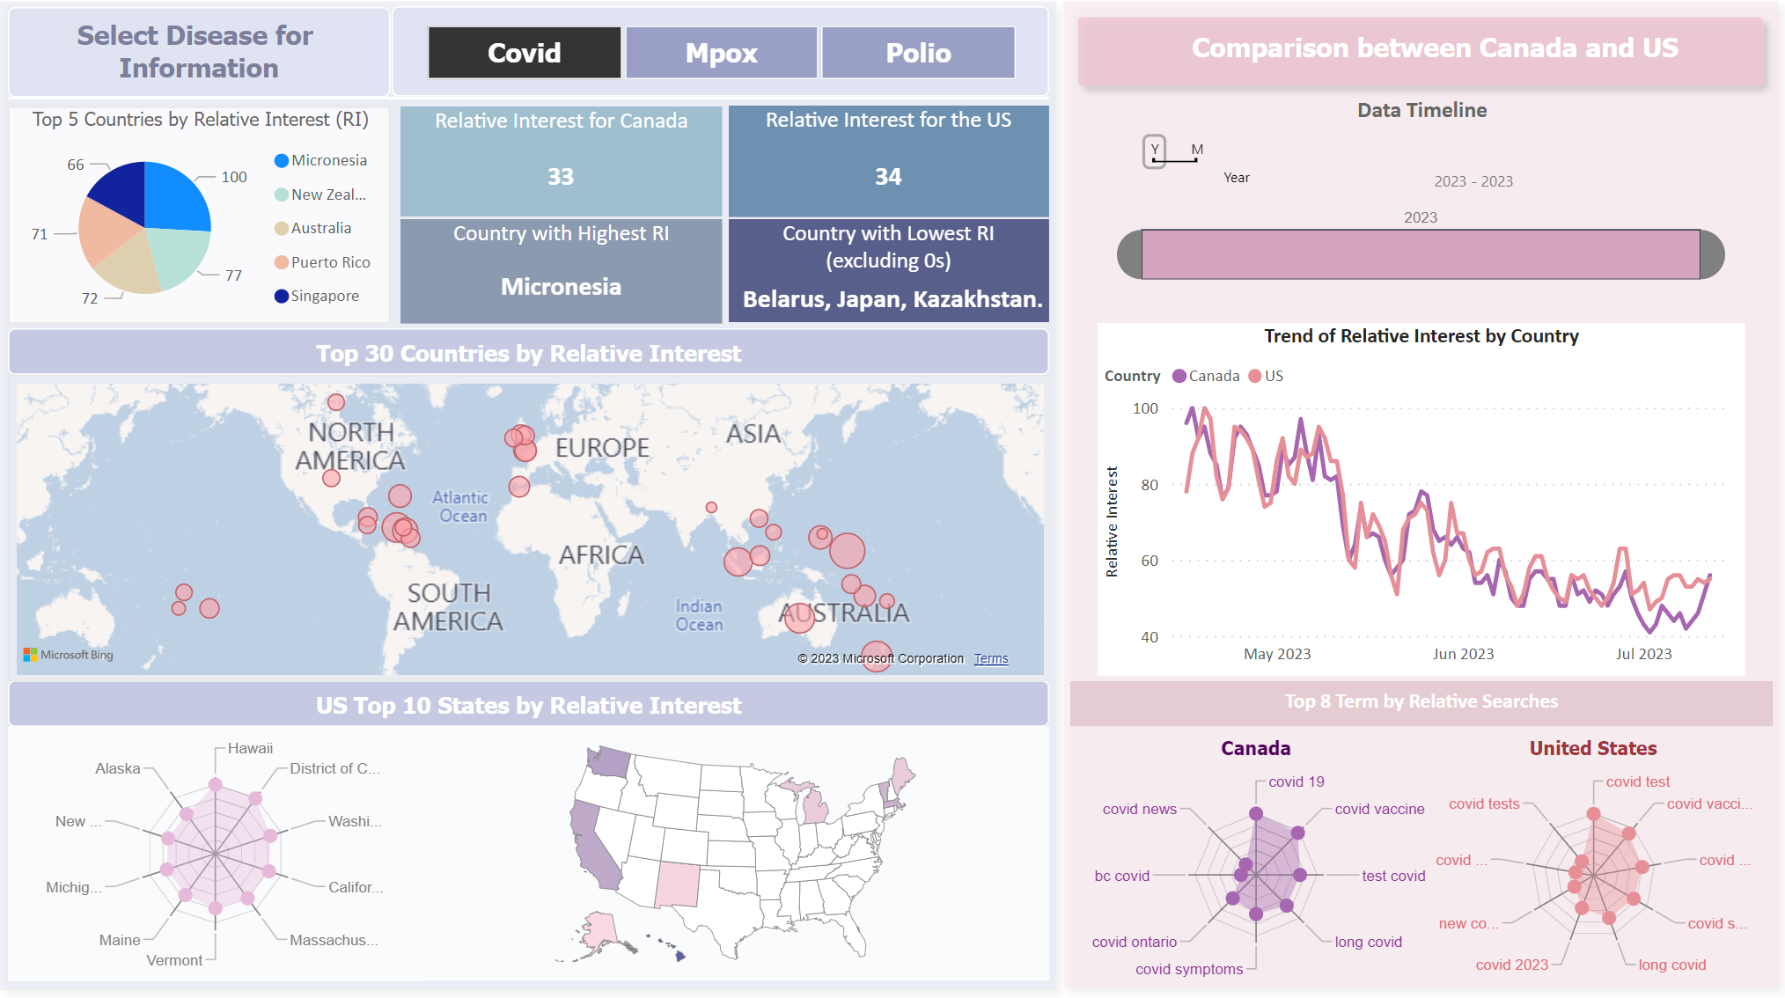
Public interest and concerns
Google Trends data is available at an international level as well, allowing for comparisons in topics of public interest across different countries.
‹#›

Slide 20
Next Steps Pilot 2: As we move forward, we have identified key areas for enhancement and exploration:
Define Signal Detection Approach: Develop strategy to automate detection of signals of interest.
Identify if There is an Audience: Currently, this is a tool to provide the VCMI team with a quick overview of online searches relating to a disease, but a further audience has yet to be identified.
Explore Methods for Expanding Scope: More data could be captured, but currently it is challenging. The limitations could be overcome if there was incentive.
‹#›

Slide 21
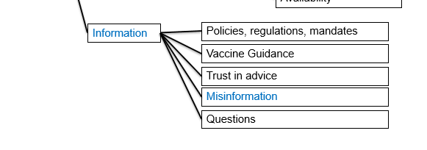
Initial Pilot Focus 3:What misinformation or misconceptions are circulating online regarding vaccines?
‹#›
Notes:
‹#›

Slide 22
Planned Approach
Analytic framework
Volume and Reach Metrics:
Status:
Sentiment Analysis:
Status:
Topic and Theme Analysis:
Status:
Contextual Analysis:
Status:
Time-based and Trend Analysis: :
Status: in development
Demographic Analysis:
Status: under consideration
Target Key Insights and Benefits
TODO: Complete this slide
‹#›
Notes:
‹#›

Slide 23

Misinformation – why does it matter?
Ability to break down misinformation into specific narratives and quantify their engagement.
Ability to identify where manipulation has taken place to push particular narratives.
Which in turn will:
Improve PHAC’s ability to develop relevant fact-based external facing products in partnership with other program areas and CPAB.
Increase PHAC’s ability to ensure that external-facing products are relevant and aligned with questions and discussion topics that are trending online.
‹#›

Slide 24



Misinformation – the challenges
Problem:
Misinformation is regularly shared on social media, but creating an automated approach to identifying it is challenging, and there is too much data to manually wade through.
Solution:
Fact Checker Data:
CIS used a publicized database of fact-checker articles relating COVID to quickly create a database of links containing misinformation.
Cross-Referencing With Our Data
These links were searched within our Tweet Database, and the total retweets for each link were counted.
‹#›

Slide 25
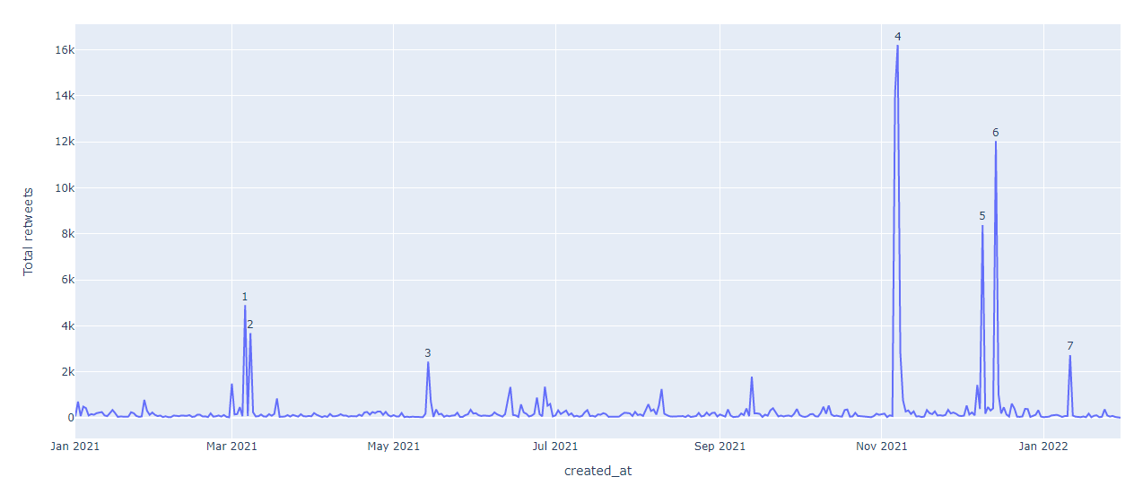
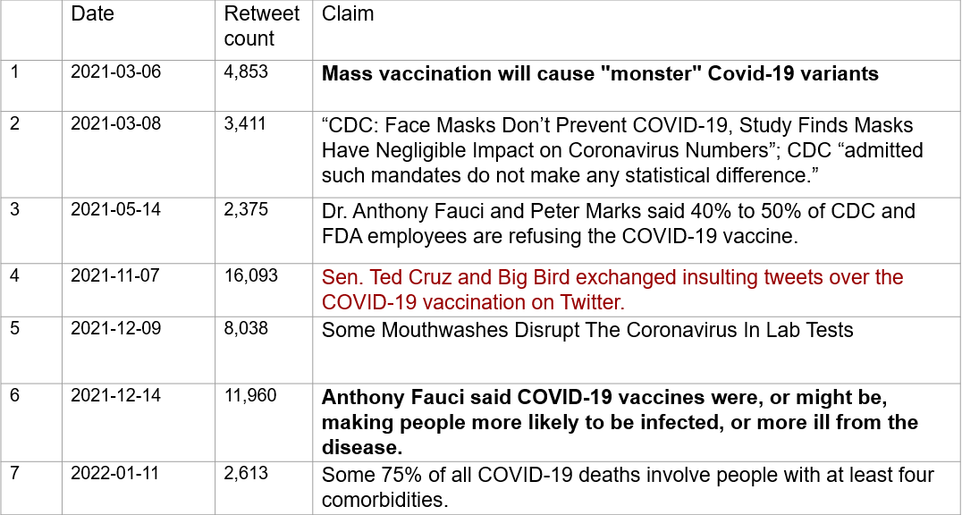
Fact-checked misinformation articles shared on Twitter
This shows the total number of retweets for all Tweets that linked to articles found in the fact-checked misinformation database developed by CIS.
More information about numbered peaks on next slide
‹#›

Slide 26
How can we improve PHAC’s ability to detect and respond to misinformation?
Problem:
Cross-referencing fact-checked misinformation articles on Twitter only shows a small subset of all misinformation that is shared online.
Solution:
CIS has scraped a large amount of data from Reddit, as well as associated news articles, and is currently working towards developing an algorithmic approach to categorizing these articles. This will allow social media metrics (upvotes, comments, etc) across hundreds or thousands of posts that cover a shared topic to be grouped and analysed.
‹#›

Slide 27
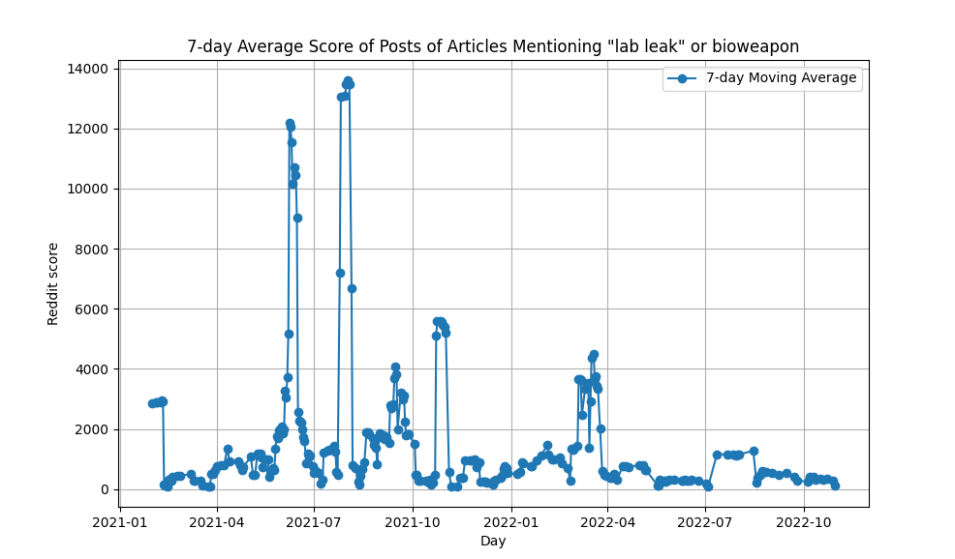
Identifying Narratives in Reddit Data
Article database was searched to identify articles that “covid” or “coronavirus” in addition to “lab leak” or “bioweapon”.
Reddit database was searched for urls to these articles

Slide 28
Categorization using ChatGPT
ChatGPT prompt:
I am going to show you an article summary. You need to categorize the article based on instructions detailed below. Only reply with a valid category name, and don't reply with anything else. Valid category names are "unnatural accidental origin", "unnatural intentional origin", "unnatural ambiguous origin", "natural origin", "unknown origin".
Determine if the article suggests that covid was developed artificially (i.e. it was designed, had unnatural origin, was developed in a lab, it was man made, it was a bioweapon). If you determine that this is true, you must further determine if the article suggests the leak of covid was intentional, or accidental, or if it leaves that part ambiguous. Use the replies "unnatural accidental origin", "unnatural intentional origin", or "unnatural ambiguous origin".
If the article suggests that covid was natural (i.e. it developed in a wet market, it developed in nature, it originated in animals, it cross from animals to humans, it has a zoonotic origin), use the reply "natural origin".
If the article suggests that the origin of covid is unknown, or it suggests a different origin that has not been described above, use the reply "unknown origin".
If the origin of covid isn't discussed in the article, use the reply "N/A".

Slide 29
Categorization using ChatGPT
Natural Origin
Covid-19 emerged naturally and is not is the product of an accidental leak from a Chinese laboratory, according to a team of internationally-regarded virologists, following a review of all available evidence. “There is currently no evidence that Sars-CoV-2 has a laboratory origin . There is a substantial body of scientific evidence supporting a zoonotic [animal-to-human] origin for Sars-CoV-2,” they conclude. “The failure to detect a potential natural host has stimulated suggestions by some that the Covid-19 pandemic has resulted from the escape of an engineered virus from a lab in Wuhan, China. It makes a strong case for the natural origin of the virus followed by on-going adaptation in humans”.

Slide 30
Categorization using ChatGPT
Unnatural Accidental Origin
Dr. Robert Redfield, the former director of the Centers for Disease Control and Prevention, told CNN he believes the coronavirus originally escaped from a lab in Wuhan, China. Redfield stressed he was not implying "intentionality," and no credible scientist, including Redfield, believes the virus was man-made. It's not unusual for respiratory pathogens that are being worked on in the laboratory to infect the laboratory worker." "Most of us in a lab, when trying to grow a virus, we try to help make it grow better, and better, and better, and better, and better, and better so we can do experiments and figure out about it. He noted that if the virus had escaped from a lab, that would mean that "it essentially entered the outside human population already well-adapted to humans."

Slide 31
Categorization using ChatGPT
Unnatural Intentional Origin
Representative Mo Brooks (R-AL) claimed that the COVID-19 pandemic was a manmade “bioweapon” created by the Communist Chinese during a Saturday appearance on the Fox News Channel. “[T]he bottom line is this — and people need to understand this: This is a bioweapon that was created in the Wuhan bioweapons lab of the Communist Chinese Party, in conjunction with the People’s Liberation Army,” he said. That isn’t going to work.”FNC’s Jacqui Heinrich questioned the merits of Brooks’ claim, adding there was “not any proof” of the claim it was a “bioweapon.”Brooks insisted he had seen proof and doubled down on the claim. It is manmade, and it was manmade at the Wuhan bioweapons lab. But I can say that with a high, high, high degree of confidence, and that’s my belief.”Follow Jeff Poor on Twitter @jeff_poor

Slide 32
Next Steps Pilot 3: As we move forward, we have identified key areas for enhancement and exploration:
Develop Categorization Methodology: Use ChatGPT and other machine learning tools to categorize articles all articles. Expanding on the example above, this will enable us to break down lab-leak articles into those that suggest the origin was natural or artificial, and compare their engagement over time. Of course, this will also enable us to look at a much large swathe of topics as well.
Determine Scope of Analysis: Once a reliable categorization methodology is selected, there are a lot of possibilities for further analysis. We can look at what narratives were the most popular over time; we can identify patterns in how narratives first gain popularity and then return; we can investigate where specific narratives came from; we can focus on summarizing topics that are being discussed presently (once Reddit and Twitter API access are acquired); we can look into articles at different timepoints for a narrative and see how the evidence has adapted to debunks over time. Prioritizing and limiting the scope of initial work will be crucial to completing the next phase in a timely manner.
Define Core Metrics and Visuals: Establish key metrics and visual representations for effective data dissemination
‹#›

Slide 33
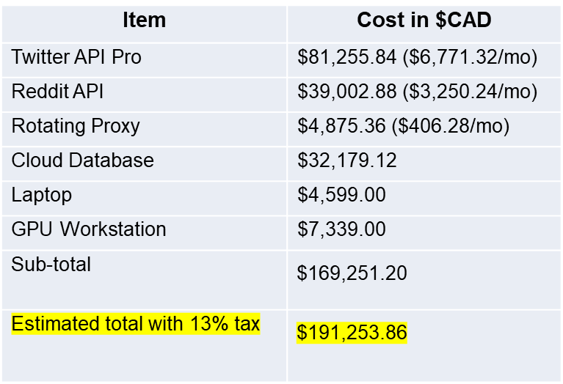
Current needs
CIS has a large amount of historical data from Twitter, Reddit, Google Trends, and news sources, and has demonstrated the ability to collect and analyse social media data in near-real time. However, recent policy changes from Twitter and Reddit are leading to costs linked to data acquisition.
In order to continue and expand on this work, CIS requires access to APIs and hardware upgrades to carry-out data acquisition and analysis, including training and running large language models (unfeasible in the long term with current equipment)
TODO: Update with updated budget info
‹#›

Slide 34

Next steps
Finalize privacy assessment
Other program areas have a need for data obtained from web monitoring:
Continue to engage with Vaccine Confidence (CIR) to clarify ongoing needs.
Continue to engage with Office of Public Confidence (CDSB).
CPAB.
GPHIN
PMRA
TODO: Update this
‹#›

